Slide 1
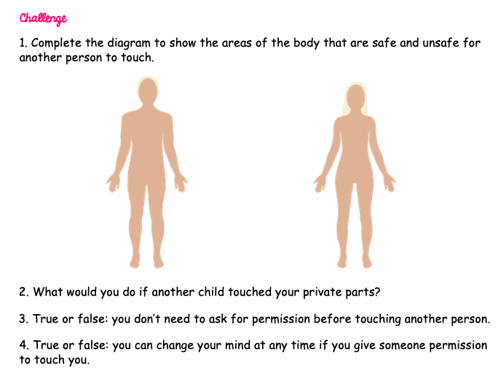
Year 4

Slide 2
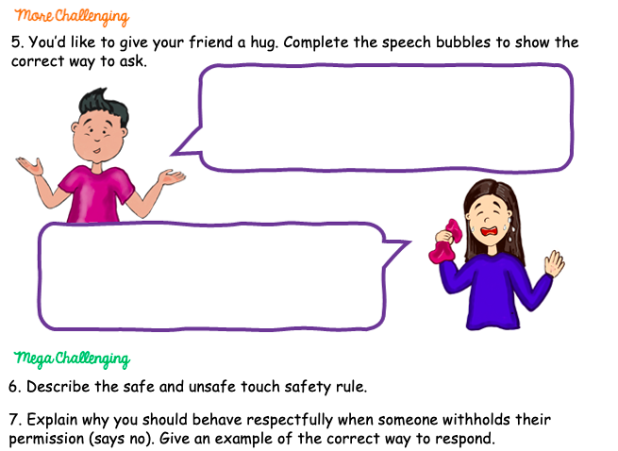
Year 4

Slide 3

'Some Secrets Should Never Be Kept' is a beautifully illustrated children's picture book that sensitively broaches the subject of keeping children safe from inappropriate touch. This book is an invaluable tool to broach the subject of safe and unsafe touch in a non-threatening and age-appropriate way. Suitable for children aged 3 to 12 years.
Story is a great medium to discuss difficult topics. 'Some Secrets Should Never Be Kept' was written to ensure children are armed with knowledge if they are ever touched inappropriately; and from the first unsafe touch, a child will understand to tell a trusted adult and keep on telling until they are believed. It is an important book and one that all children need to hear. Forewarned is forearmed!
Year 4

