Slide 1
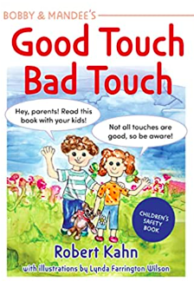
Year 3
Good Touch, Bad Touch is a must-read for all parents who want their children to learn to advocate for their own safety and personal boundaries.
When it comes to bad touches, Bobby advises children, "Whether it is a stranger, or someone you know well, the rules to be safe are always the same: Say no! Run away! And find a grown-up friend to tell!"
This book is designed for parents to read with their children, and for teachers to share with their classes.

