Slide 1
Year 1

Slide 2
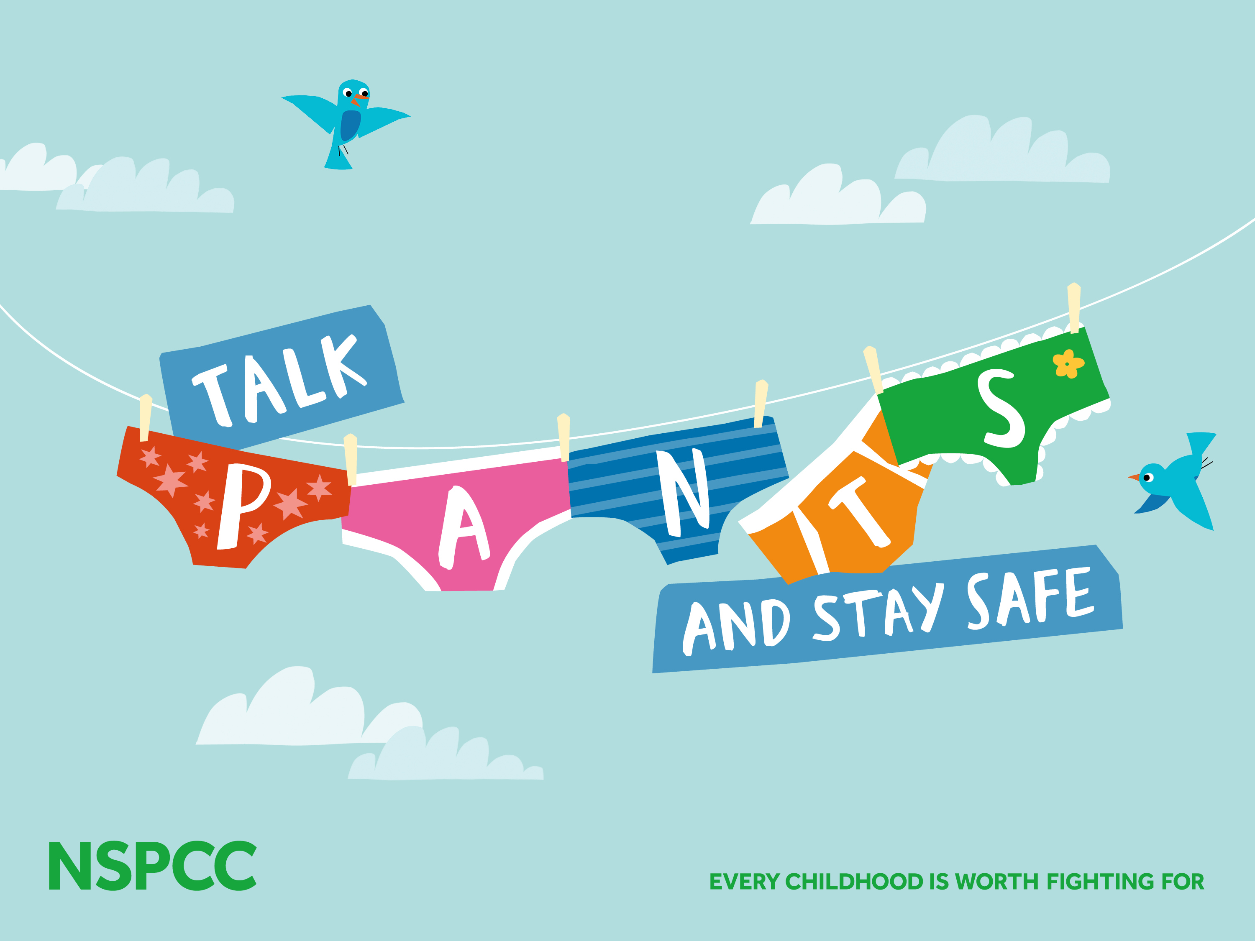
https://www.youtube.com/watch?v=LnroTxz7USI

Slide 3
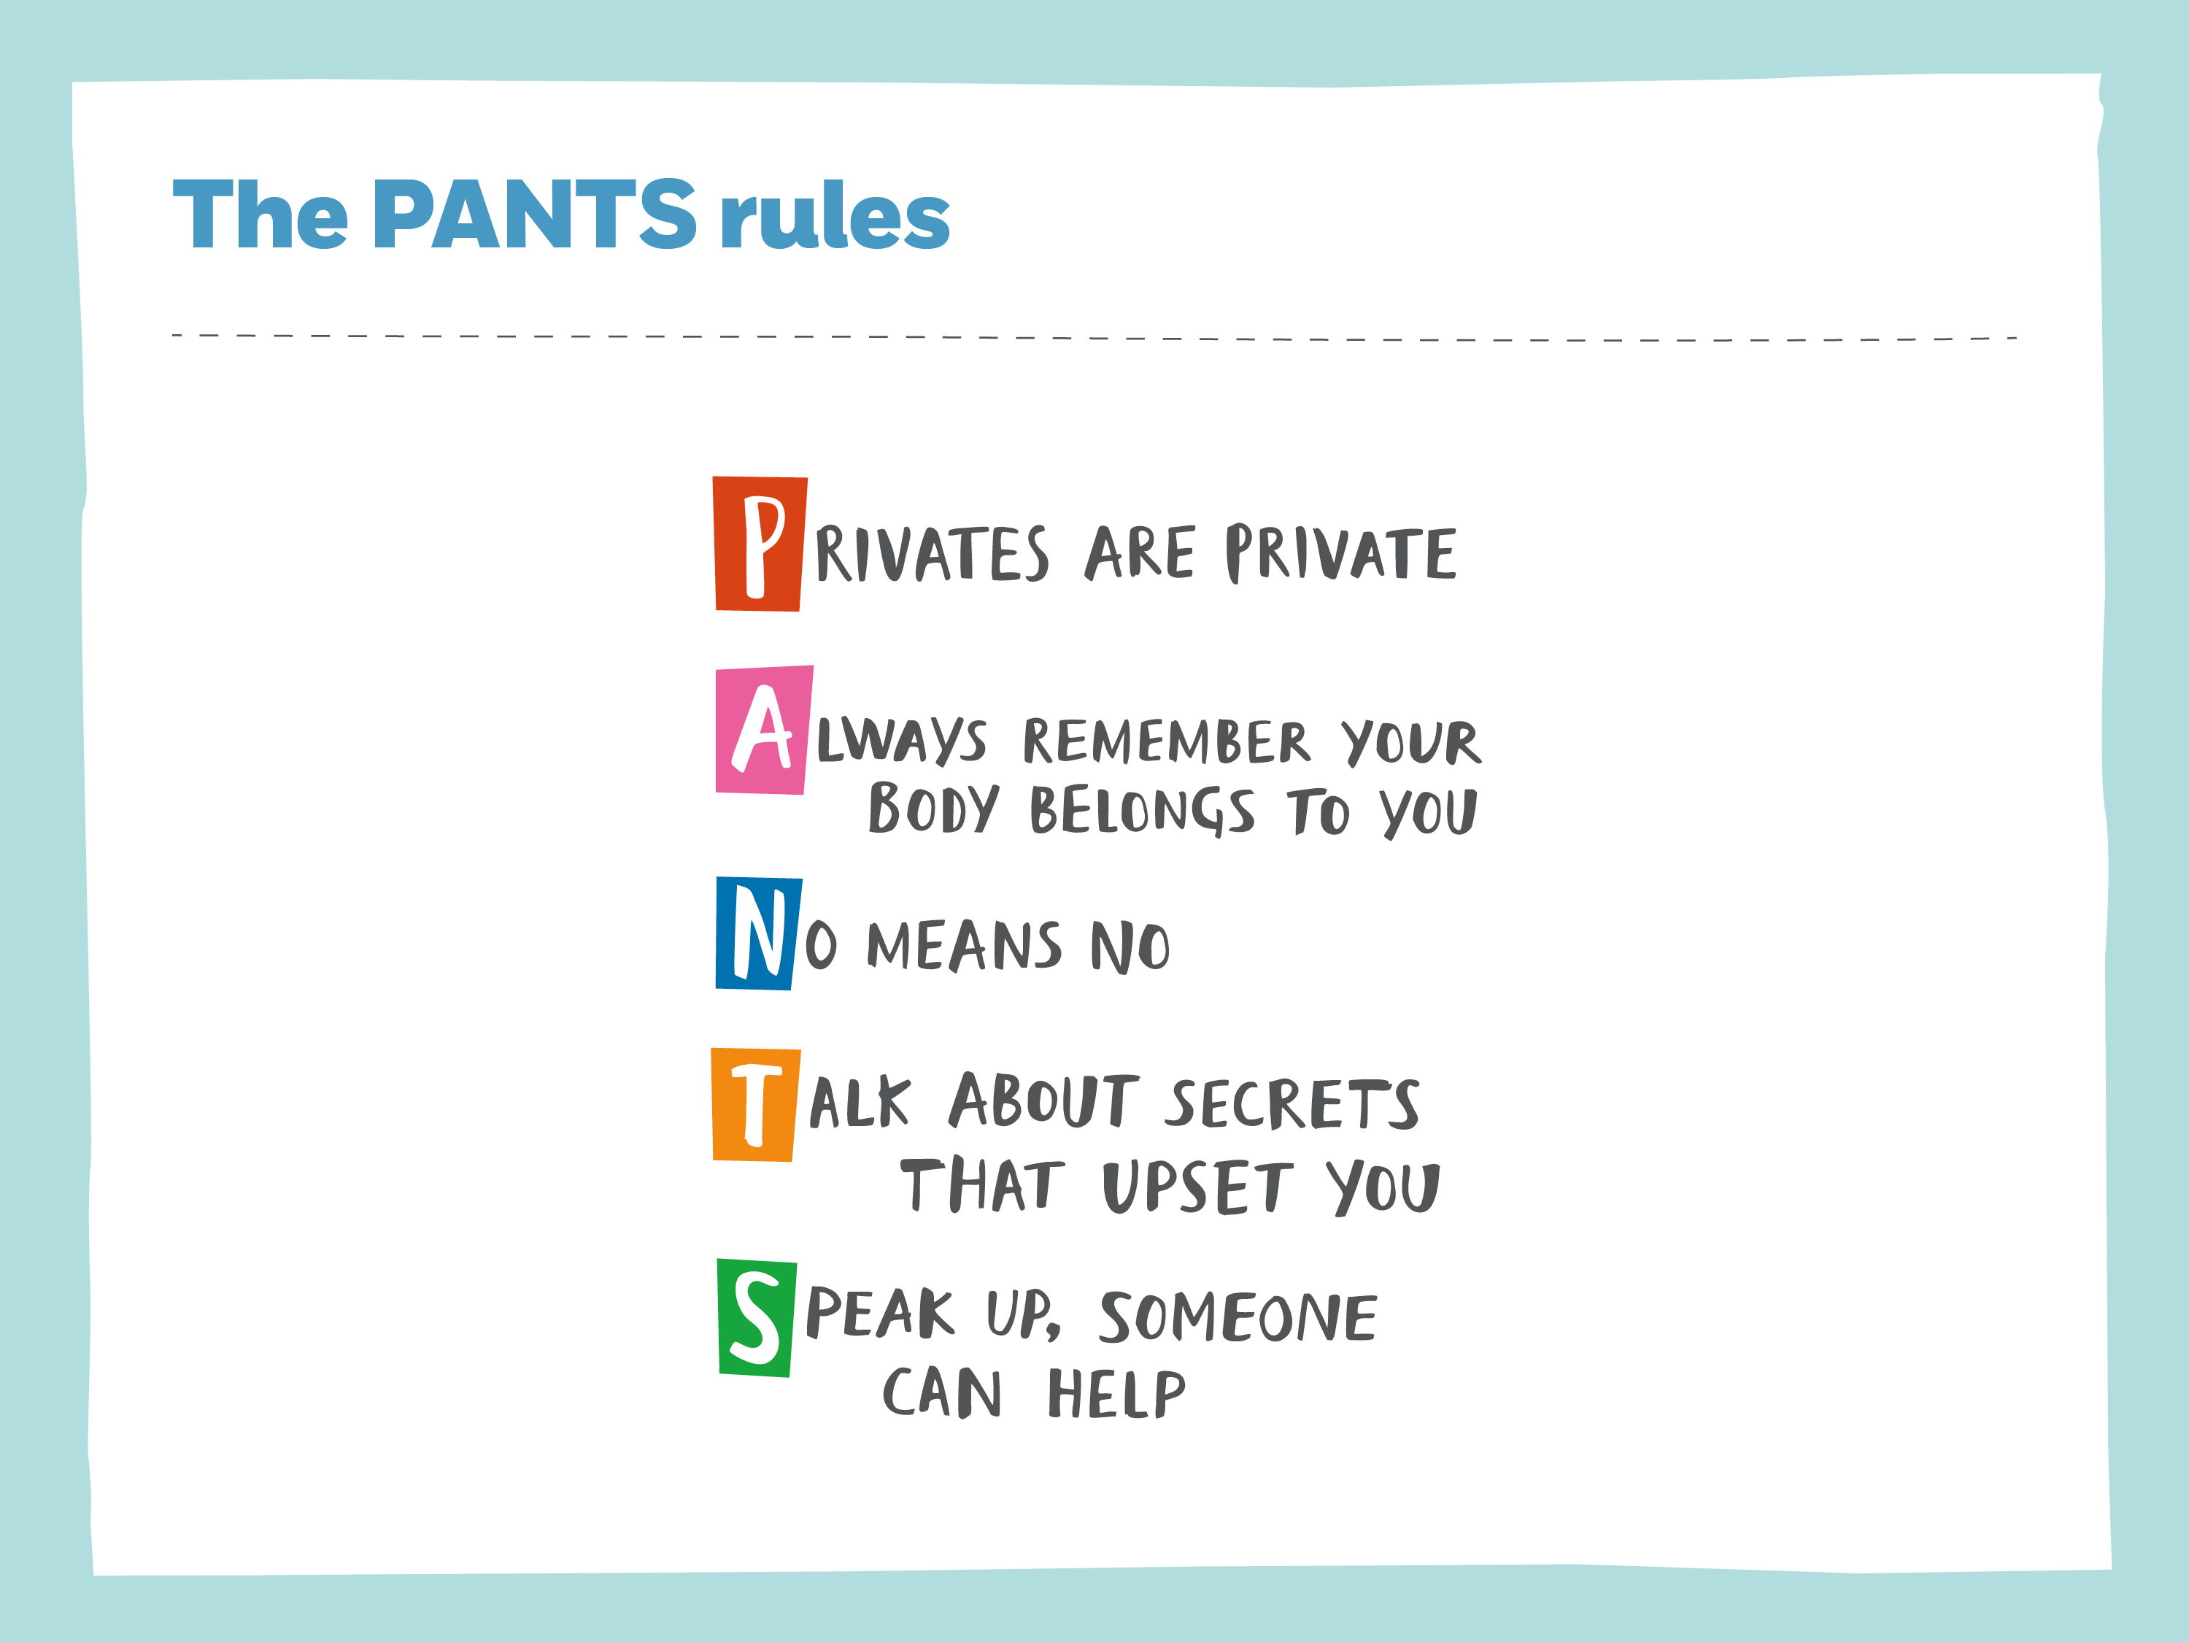

Slide 4

Year 1
Doug doesn’t like hugs. He thinks hugs are too squeezy, too squashy, too squooshy, too smooshy. He doesn’t like hello hugs or goodbye hugs, game-winning home run hugs or dropped ice cream cone hugs, and he definitely doesn’t like birthday hugs. He’d much rather give a high five - or a low five, a side five, a double five, or a spinny five. Yes, some people love hugs; other people don’t. So how can you tell if someone likes hugs or not? There’s only one way to find out: Ask! Because everybody gets to decide for themselves whether they want a hug or not.

Slide 5
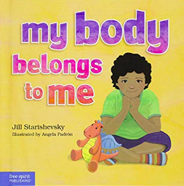
Year 1
Without being taught about body boundaries, a child may be too young to understand when abuse is happening or that it's wrong. This straightforward, gentle book offers a tool parents, teachers, and counsellors to help children feel, be and stay safe. The rhyming story and simple, friendly illustrations provide a way to sensitively share and discuss the topic, guiding young children to understand that their private parts belong to them alone. The overriding message of My Body Belongs to Me is that if someone touches your private parts, tell your mom, your dad, your teacher or another safe adult.

